Slide 1
Paydirt: Valuing and utilizing sediments
Brandon Kelly
Mentored by dr. Jordon buckler
Florida Atlantic university REU on Renewable Energy
Summer 2022
Notes:
When I was growing up in Southwestern Pennsylvania, I was fascinated to learn that my family didn’t really own the land my house was built on.

Slide 2
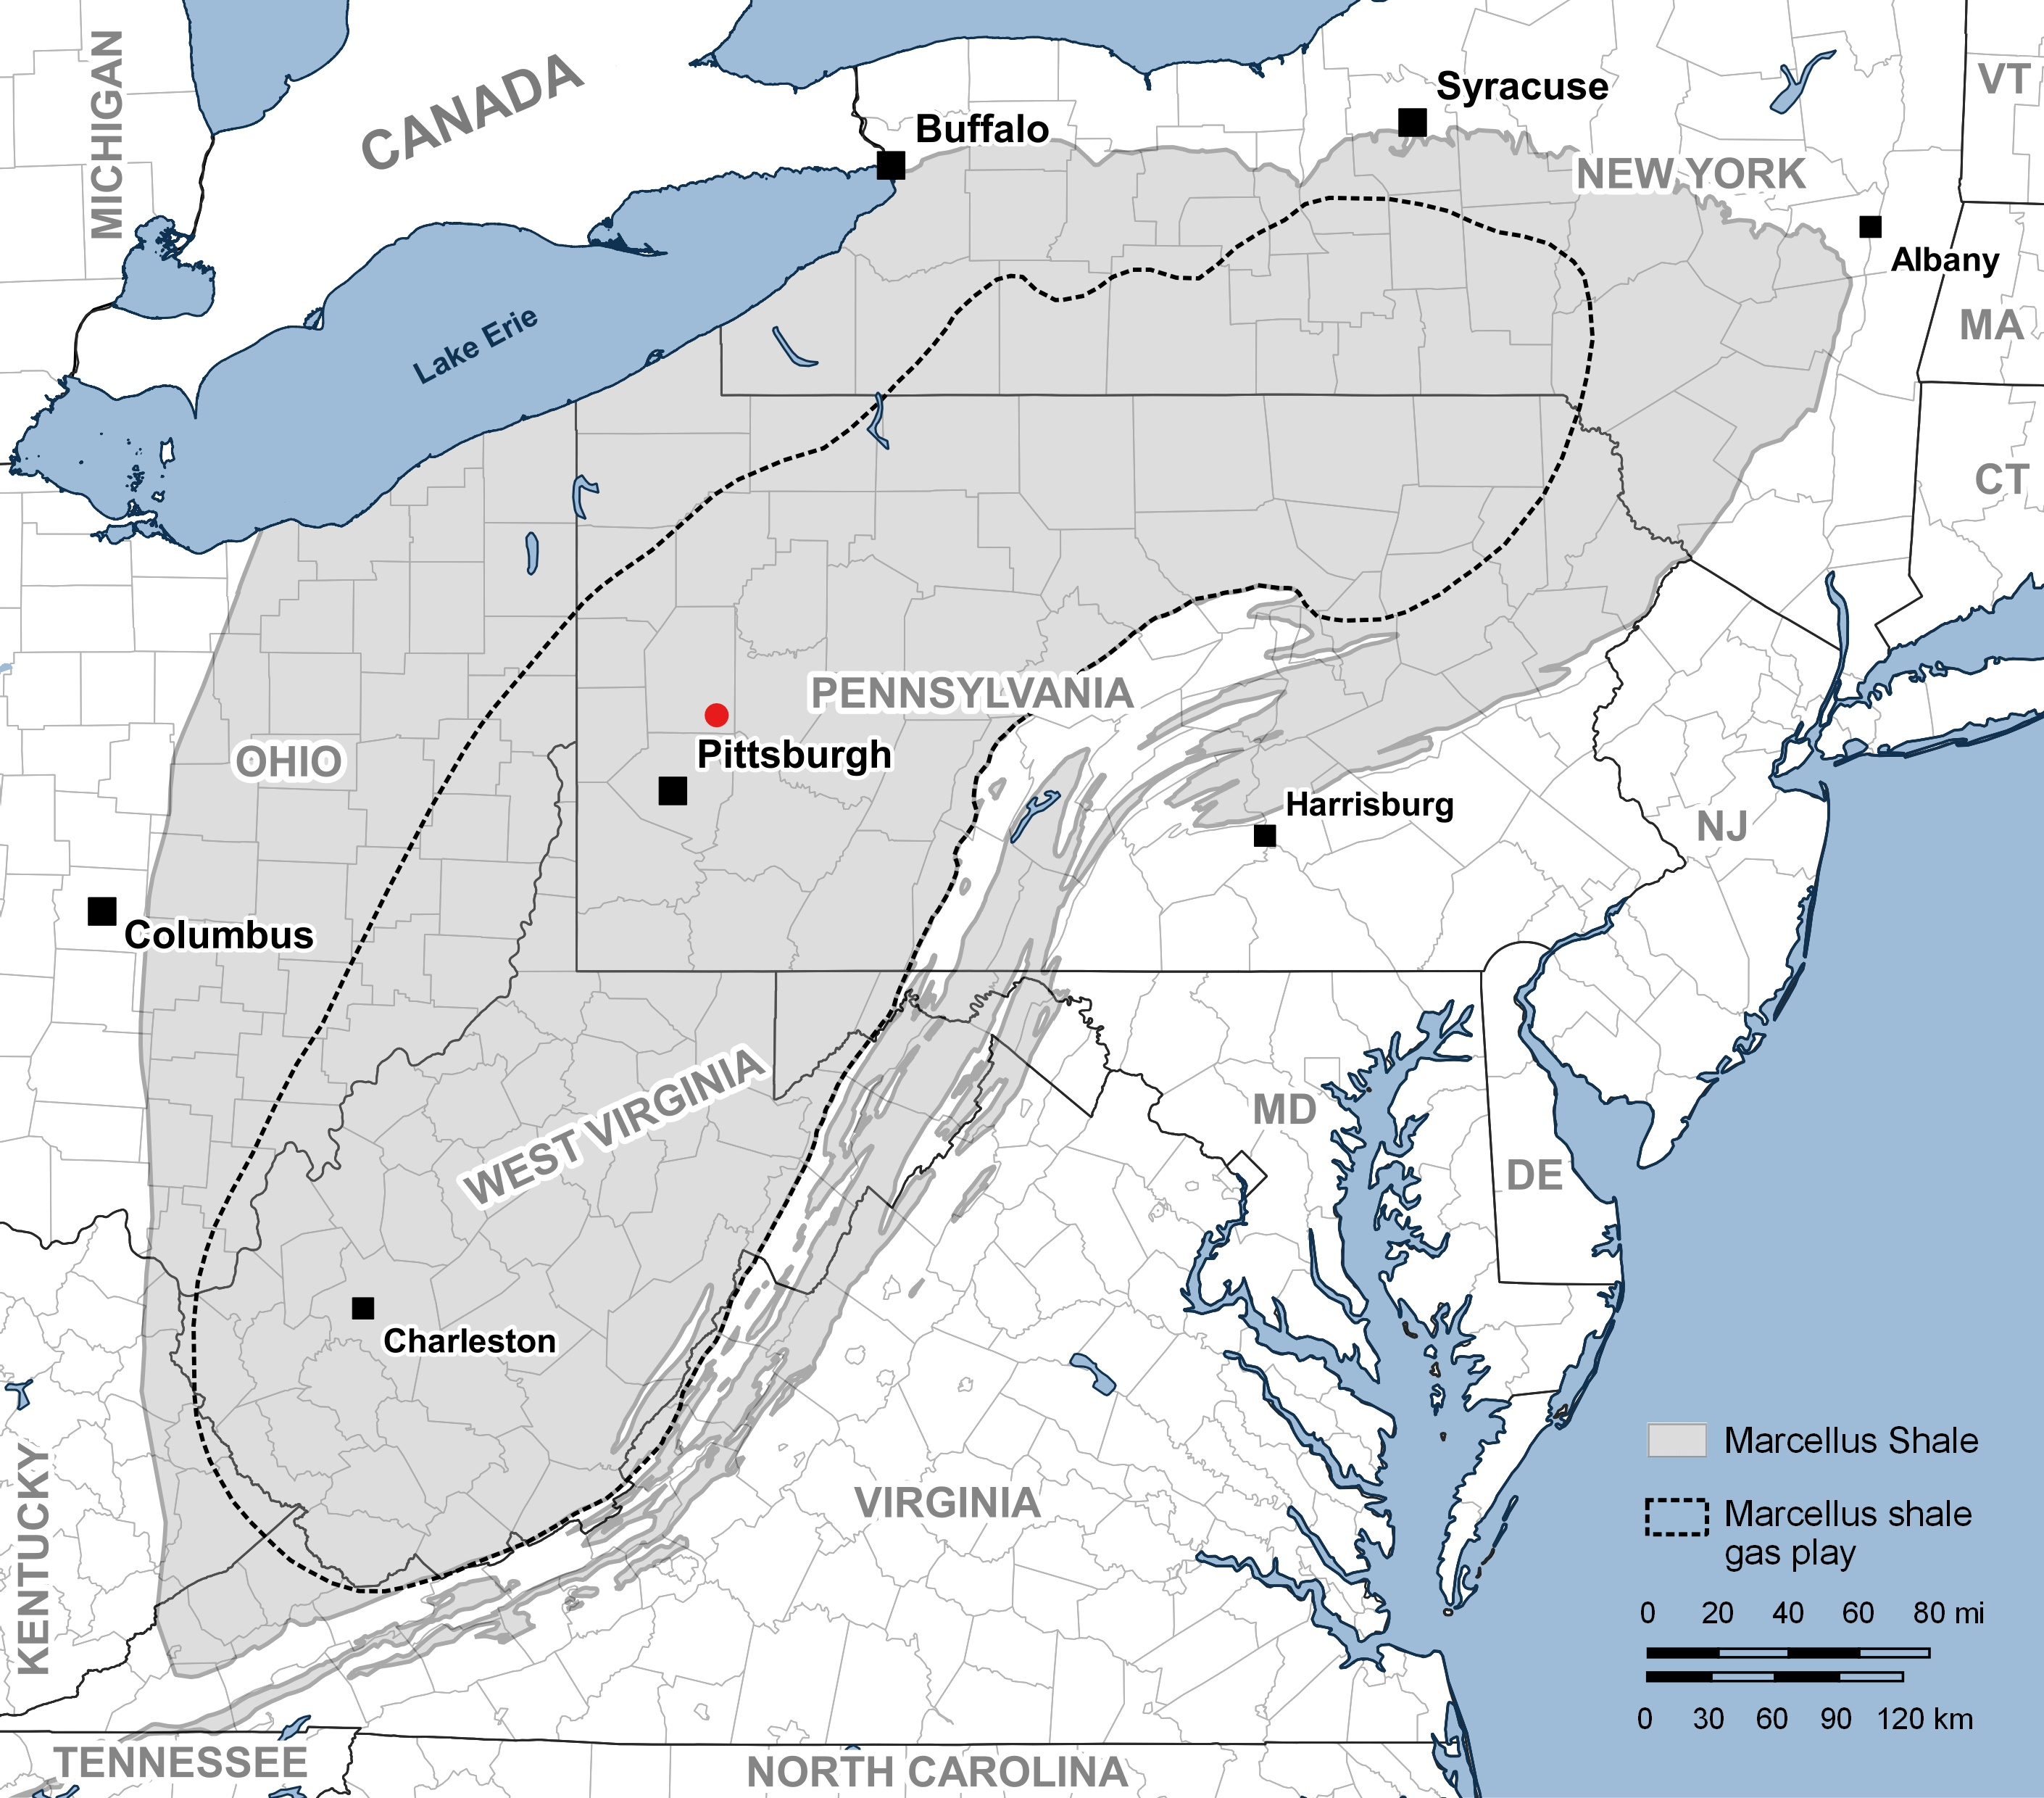
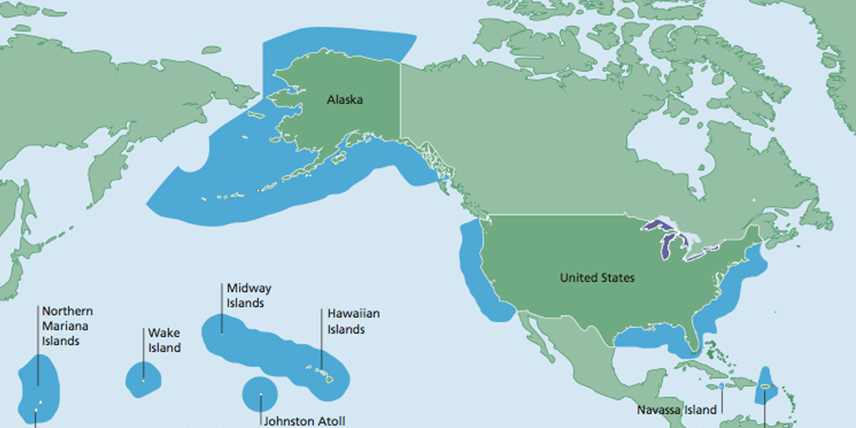
Valuing resources
Valuing land resources
Valuing marine* resources
*(& Freshwater)
?
Notes:
More correctly, we didn’t own the mineral rights and being in shale and coal country there was quite a bit value tied up in those rights. Land based resource rights are something well understood by the majority of people. However, there is more uncertainity based on the value of marine resource rights. While the value of oil is something well quantifed, we have 260,000 square miles of sediments that are not properly assigned value.

Slide 3
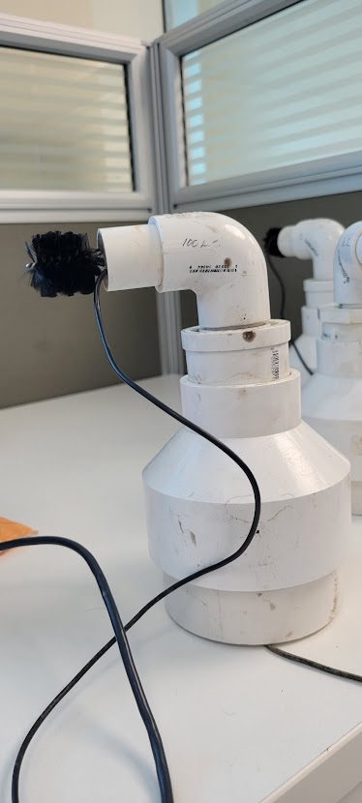
Value of “dirty” energy
Benthic Microbial Fuel Cells:
Generates Electricity Using Microbes and Nutrients in Sediment
Allows us to Monitor Sediments Long-Term
Can Power Remote Sensor Network
Normalize Power Production by Footprint Area
Can Control Placement Density to Control Resolution
Notes:
One of the major ways we can assess value to sediments is based on their potential for Energy Production. Benthic Microbial Fuel Cells give us a tool to quantify these metrics. The fuel cells have two major ways they contribute to this effort. 1. Monitoring the Sediments and Surrounding environment for health, nutrient changes, and other factors(including ones separate from sediment) and two they can actually gives the power production per unit area. By changing the placement density, we can change the resolution to either cover large swathes of the sea or get detailed mapping of areas of interest.

Slide 4
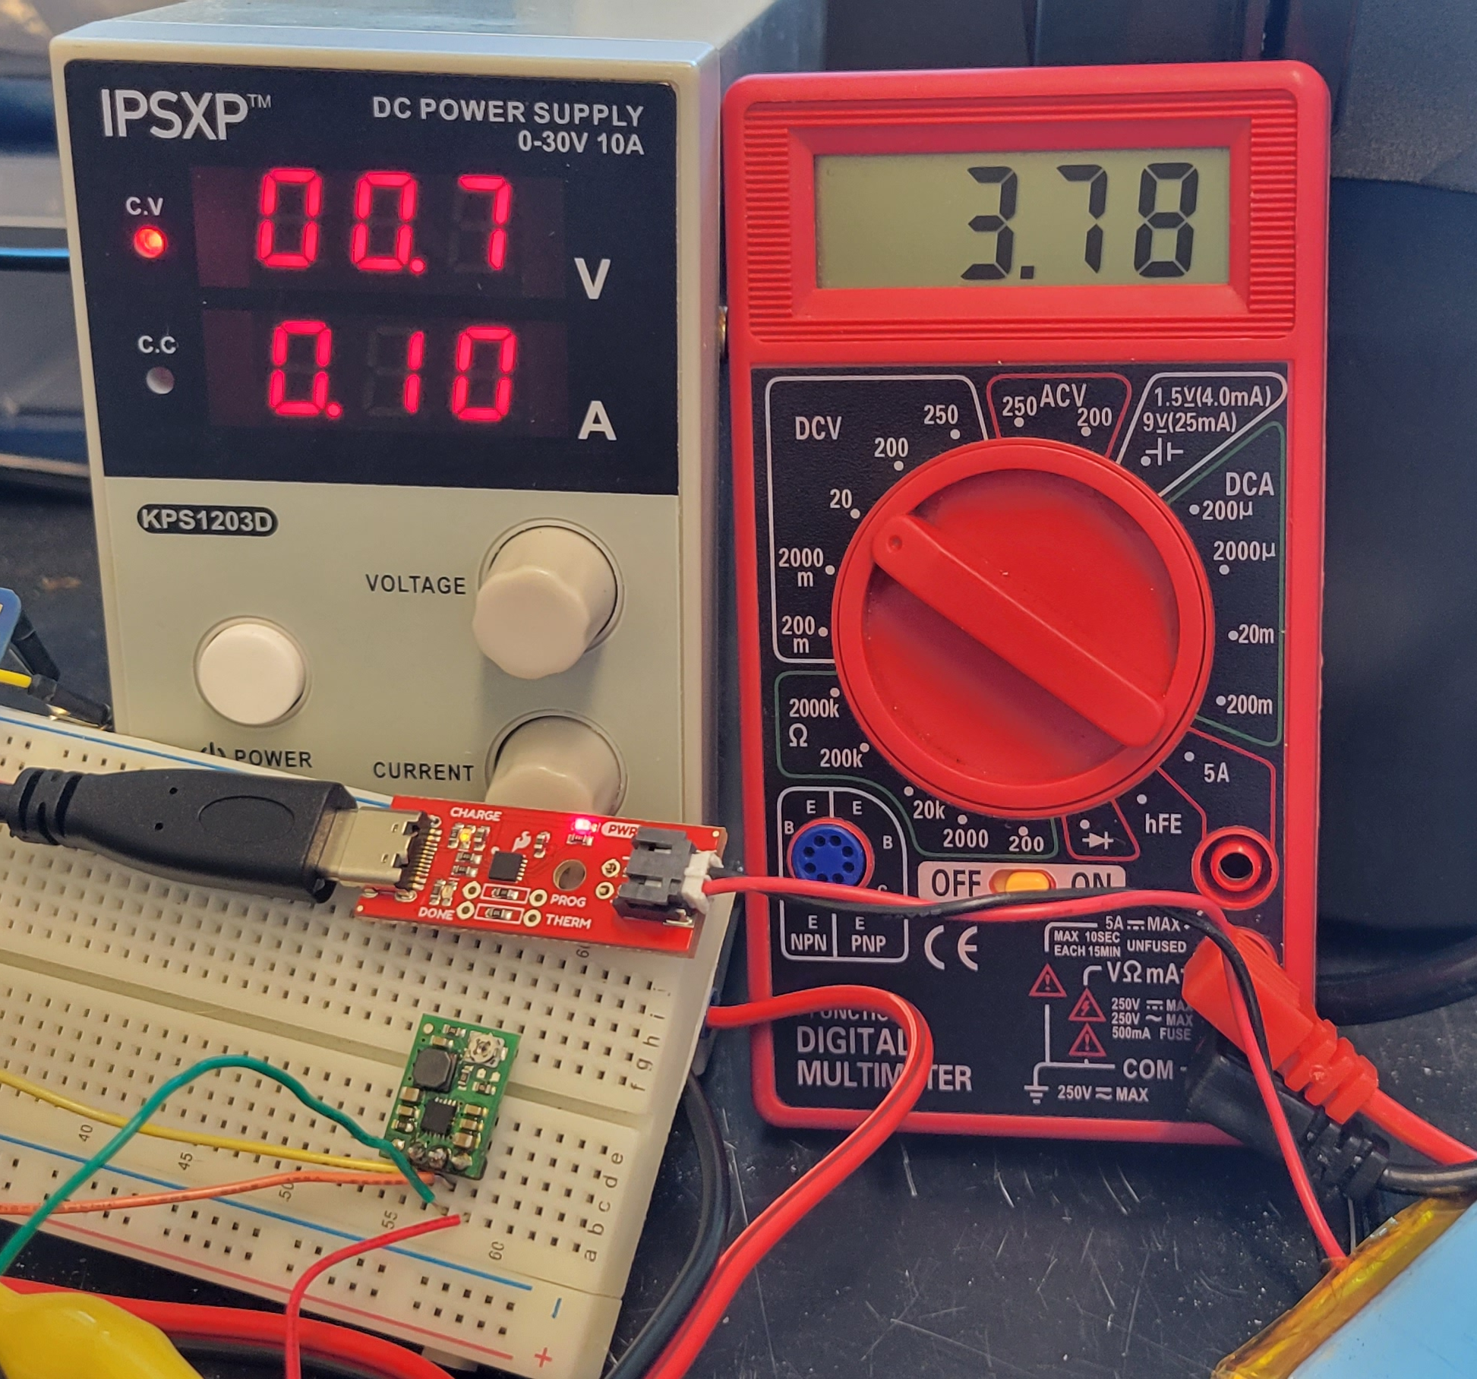
Harvesting Power
Low Voltage
Step Up Converter: “Trades” Current for Voltage
Low Power
High Efficiency, Low “Quiescent Current”
Output Agnostic
Delivers Power No Matter Destination
Notes:
My research this summer has been primarily focused on taking this fuel cells and using them to power sensors and other equipment in the benthic zone, that is the bottom layer of a water system. There are several primary concerns that I had to design for. Most sensors need to be powered at significantly higher voltage than the fuel cells natively produce. DC-DC converter talk. We also have to deal with low power production, thus efficient electronics. We also want the power to be output agnostic, meaning that we don’t want the power system to require communication from the sensor package

Slide 5
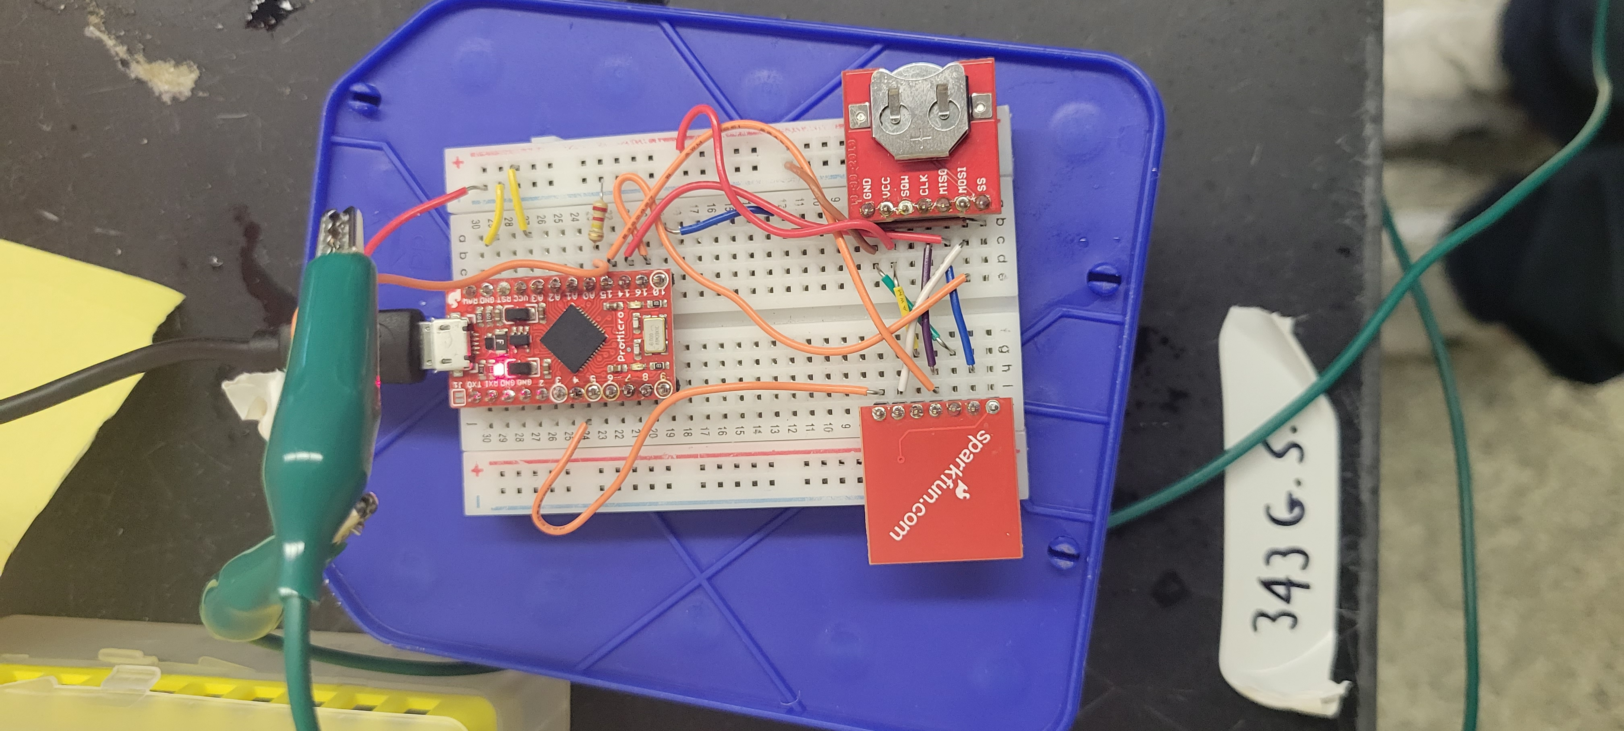
Capturing data
Tracks Voltage of Fuel Cell
Measures Fuel Cell Performance over time
Modular Electronics
Easily Add Thermometer, Ph, Salinity Meters
Designed for Conversion to In Situ Deployment
Low Power Board Chosen
Code has Optimizations
Notes:
Another somewhat parallel development I worked on. This is a possible sensor package for the fuel cell. It allows to collect timestamped voltage data to measure the fuel cells performance overtime. Since it is based on Arduino it is incredibly simple to add a temperature monitoring with simple electronic components or a ph/salinity meter with a little more work. Also put in effort to quickly reconfigure this from lab setting to be able to go into the field

Slide 6
Questions?

